Slide 1
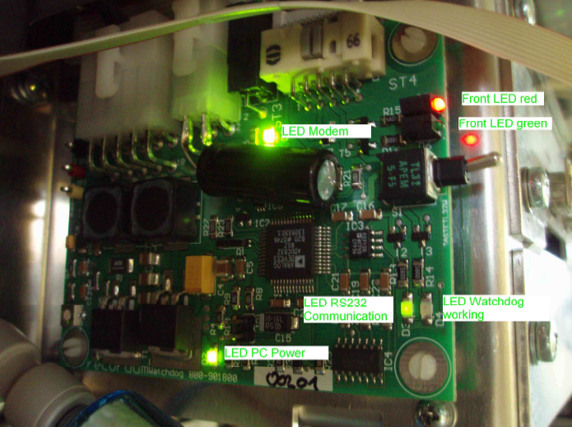

Slide 2

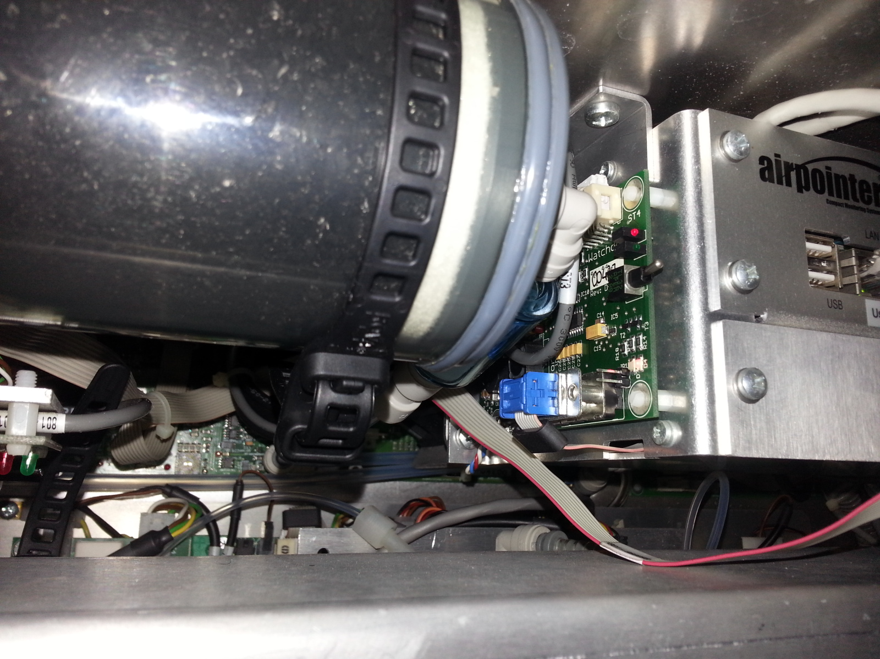
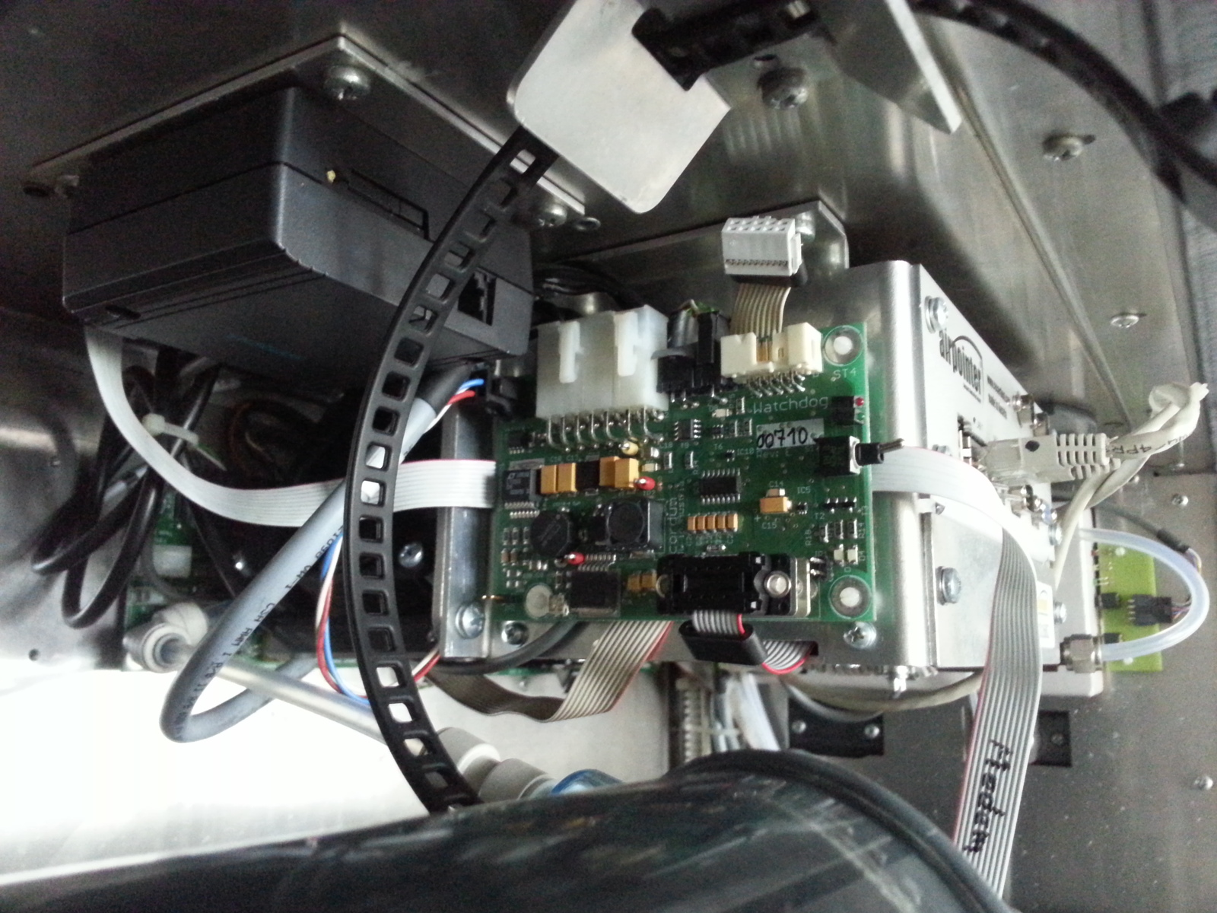
When measuring the voltage on the watchdog board, it is recommended to remove the zero air canister to have an easier access to the watchdog board and to be careful not to make a shortcut by touching 2 pins of the board simultaneously. This can destroy the watcdhog board and/or the PC.

Slide 3
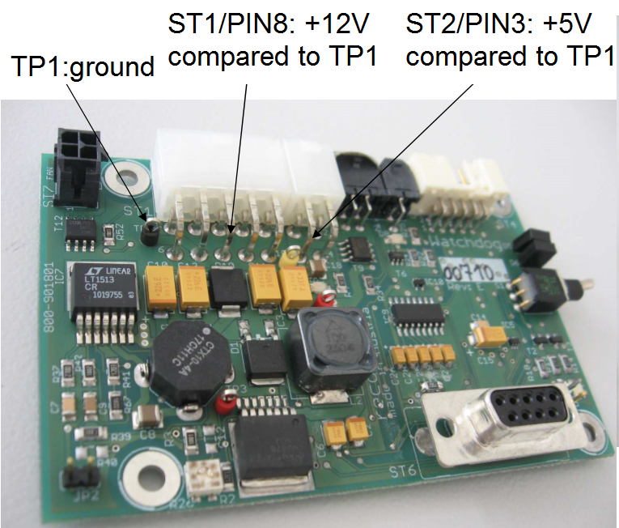
TP2:+5,1 to 5,2V
compared to TP1
TP3:+5V
compared to TP1
If necessary, adjust TP2 voltage with R26 poti

Slide 4
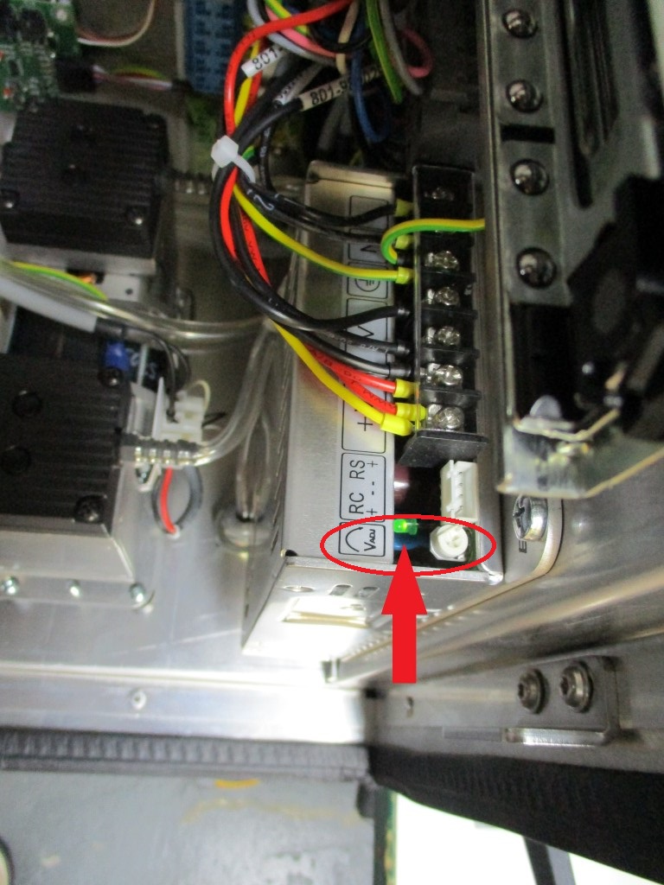
If not possible to adjust V on Watchdog board, adjust it on the power supply

